Slide 1
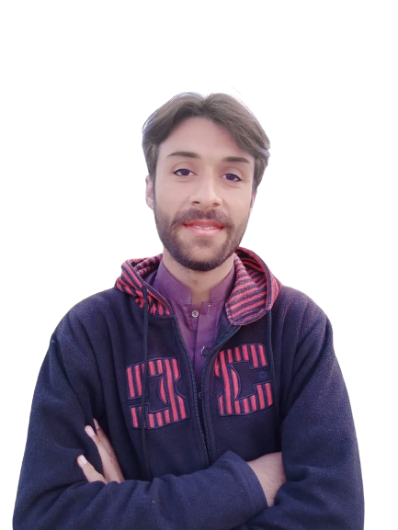
Complex Task Series
Problem Number 80

Slide 2
Problem Statement
Write a Web application in Python To Get Different Words from user, and Display Only Uppercase Words to User

Slide 3
Algorithm
Step1: Install Python Django Library
Step2: Create Project
Step3: Create Application And Include In Settings.Py File In Django Project
Step4: Create Template Directory In Application
Step5: Create HTML File In Application Template
Step6: Create Form to get User Item
Step7: Write view for HTML file in views.py
Step8: Display only uppercase string from list
Step9: Write URL for Home view in urls.py
Step10: Display Result to User
END

Slide 4
Assignment
Write Desktop application in A Python Program To Get Only Uppercase Words From User To Store in A List

